Slide 1
Frankenplanes
AME CONFERENCE presentation
Multi mod aircraft

Slide 2

On every STC certificate we read…..
“Conditions: this approval is only applicable to the type/model of aeronautical product specified therein. Prior to incorporating this modification, the installer shall establish that the interrelationship between this change and any other modification(s) incorporated will not adversely affect the airworthiness of the modified product”

Slide 3
The Scope of what we’ll be discussing:
In this presentation, we’ll be reviewing a number of factors which become more important when multiple modifications are accomplished on an aircraft.
The main theme for this presentation will be general aviation airplanes, and in particular Cessna floatplanes and amphibians, though the discussion of the effects of multiple modifications can be appropriate for any class of aircraft.

Slide 4
Background
Since the early 1980’s, the tail end of large GA production, there has been a shift from owners accepting the airplane as manufactured, to major restorations of airplanes which are no longer in production, and unlikely to ever be produced again – if you can’t buy a new one, restore an old one.
The result is that both commercial operators and private owners are seeing the benefit of restoring these aging airplanes to either useful bushplane, or nearly new, completely up to date condition. Accompanying these restorations is often a desire to update and modify the plane.
For all of the Cessnas, high wing pipers, and Viking/DHC-2 and -3, there is a good selection of STC approved modifications. In some cases, an STC’d kit will list compatibility with another modification, but not broadly. Sometimes, an STC’d kit will list compatibility with one mod (like a brand or size of floats) but not another very similar, and equally appropriate modification (the competitor’s floats).

Slide 5

Cessna Wing Changes
Through any of several different STC modifications, Cessna wings may be increased in both span and chord as shown
Notes:
The wing pitching moment is opposed by the downward lift produced by the horizontal stabilizer. Though the wing is modified with the combination of changes, it is uncommon for the horizontal stabilizer to be modified. The result may be that the horizontal stabilizer no longer has the effectiveness to raise the nose to flare, while power off.
The author is unaware of any of the aforementioned STC changes including instruction to evaluate this characteristic, probably because any one modification would be compliant, but the cumulative effect becomes non compliant. An installer might not consider this factor. This could result in a floatplane which cannot be held nose high enough for a power off water landing to be safe.

Slide 6
Wing changes to cessnas….
The chord of the wing may be increased by several inches, full span, or more at the tips, depending upon which brand of STOL kit cuff is installed.
The span may be increased by about 3 feet with the installation of wing extensions. One brand of wing extensions can be ordered with the airfoil to match the desired STOL kit cuff – so as to continue that airfoil to the tip
The STOL kit STC’s do not list compatibility with the wing extension modifications. The wing extension does list compatibility with some STOL kits.
Neither the STOL kit nor wing extension STC’s list compatibility with the many other mods possible on the Cessnas
The increase in the wing area resulting from combining wing mods can change the airfoil pitching moment, which has the effect of seeming to reduce the effectiveness of pitch control
The original stall warning system may also need recalibration

Slide 7
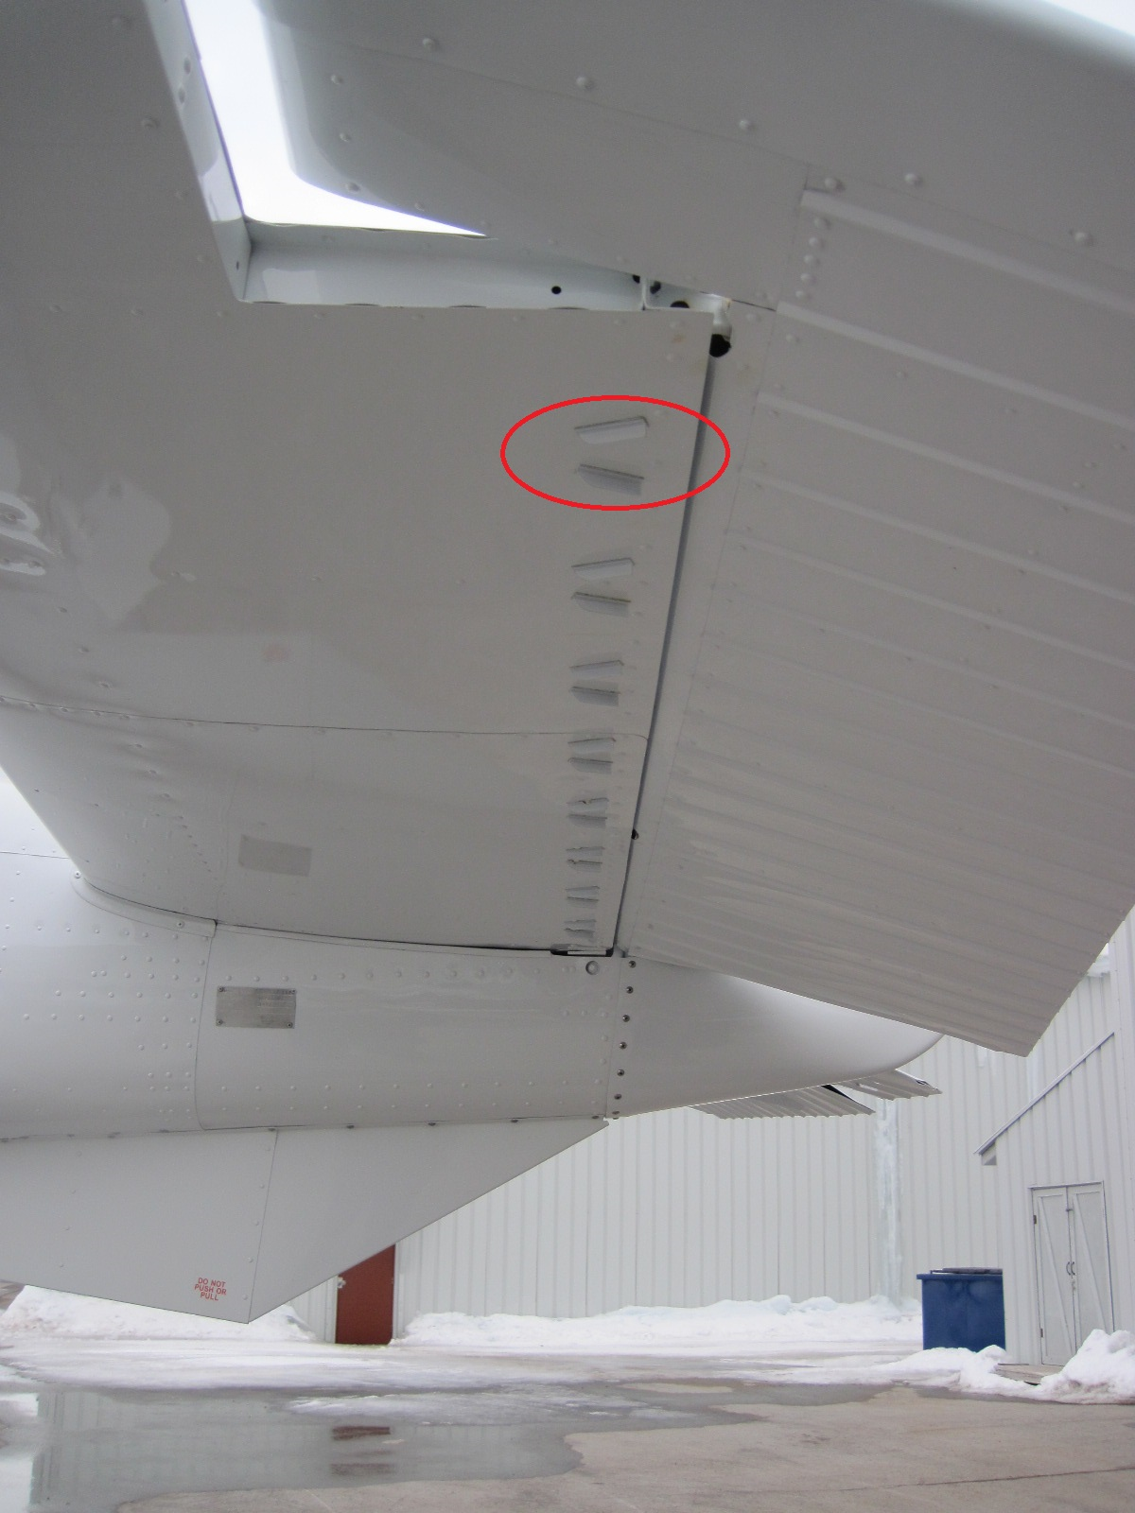
Solution
For one project on a Cessna 182Q, the author found that the installation of vortex generators under the horizontal stabilizer improved the slow speed effectiveness of the elevator enough for pitch up control that the handling characteristics returned to what is normal for the type.
Without this change, a power off water landing at forward C of G might have been dangerously nose low, risking a pitchover.

Slide 8
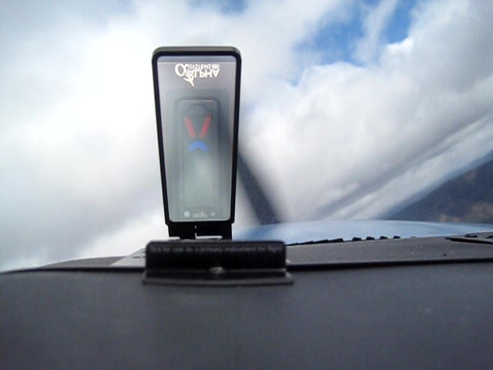
AoA and changed IAS to CAS,
Aftermarket Angle of Attack (AoA) systems are a popular modification. They are widely promoted for improving safety. They are generally calibrated in flight by the installer, with reference to the actual airplane stall.
As the calibration requires reference to stall speed, Calibrated Airspeed (CAS) should be the reference, rather than Indicated Airspeed (IAS).

Slide 9
AoA systems combined with other mods….
If an aftermarket AoA system is installed on a factory original airplane, there is probably an approved position error correction table in the Flight Manual / POH available to be used for reference for the AoA set up.
If the airplane has had other STC mods, primarily wing mods (STOL kits, wing extensions, tip fuel tanks, vortex generators), though also considering gross weight increases, and engine and undercarriage changes, the original position error correction table in the Flight Manual / POH will likely no longer be valid.
Without correct IAS to CAS conversion information for the actual configuration of the airplane, correct set up of the AoA system, and its required margins (usually 1.3Vs) cannot be assured. The AoA may indicate on the slow side and create a safety risk
In this case, calibration with a corrected airspeed source would be required. This is a major modification.

Slide 10
Weight and C of G – Example 1
Few airframe and aerodynamic modifications reduce the weight of an aircraft. GA airplanes rarely have an excess of useful load. Accumulated modifications will generally reduce useful load.
A number of types have optimistically large cabins, leaving room for loads which exceed the weight capacity, already luring pilots into overloading.
There are minimum useful load requirements, and some types barely meet them.
A Canadian origin GA airplane has a gross weight of 3500 pounds. The empty weight of one known to the author is 2469 pounds. It’s approved with six seats (6x170=1020), so with six 170 pound occupants, it has 11 pounds remaining useful load for fuel. An AME/AMO needs to give this thought before agreeing to the installation of any modification on this plane!

Slide 11
Weight and C of G
Sum of Mods and Empty Weight, Example 2
A Cessna 182 in the U.S. is rebuilt with modifications including a float kit & floats, power increase by engine and propeller change, VG kit, wingtip extensions, canards (on the nose cowl – for slow flight), gross weight increase to 3100 pounds, among other mods. The list:
Seaplane’s West Float Conversion Kit SA02031NY
IO-550-D & McCauley D3A34C401 SA3825SW
Microaero VG’s SA00834SE
WING-X Extensions SA00276NY
Katmai Canards SA485SW
Trolltune 3100 MGTOW SA03608AT
Seaplanes West Engine Mount SA01573NY
Trutrak Autopilot SA04231CH
The weights for a normal 182Q wheel plane are: Gross 2950 pounds, empty 1750 pounds, and useful load of 1200 pounds. The result of the sum of the mods to this plane was an empty weight of 2535.6 pounds, which results in a useful load (3100 – 2535.6 = ) of 564.4 pounds. With a standard fuel capacity of 88 gallons (6 lb/gal) = 528 pounds, the plane as equipped can just meet the requirements of CAR 3.75
Notes:
§ 3.75 Minimum weight. The minimum weight shall not exceed the sum of the weights of the following:
(a) The empty weight is defined by § 3.73.
(b) The minimum crew necessary to operate the airplane (170 pounds for each crew member).
(c) One gallon of usable fuel (see § 3.437) for every 12 maximum continuous horsepower for which the airplane is certificated.
(d) Either 1 gallon of oil for each 25 gallons of fuel specified in (c) or 1 gallon of oil for each 75 maximum continuous horsepower for which the airplane is certificated, whichever is greater.

Slide 12
CAR 3 Requirements
CAR 3.75 would require: (a) 2535.6 + (b) 170 + (c) (300/12=) 25 gal x 6 = 150 + (d) (4x7.5=) 30 = 2885.6 pounds, so 214.4 pounds reserve useful load to that requirement, however the airplane cannot be flown with full fuel tanks, and pilot only, let alone any occupants, and it’s a 4 seat airplane! To fly pilot only for maximum range, 364.4 pounds of fuel (60 gallons) could be carried, which is 4 hours of flying with no reserve. To fly pilot and passenger (340 pounds), just over 2 hours fuel can be carried.

Slide 13
FAR 23 requirements
FAR 23.25(a)(2)(i) would require: (4x170=) 680 pounds of occupants + (3x7.5=) 22.5 oil + (17X6/2=) 51 pounds (knowing that operationally, this is less than half the minimum fuel required – 45 minute reserve) minimum load = 753.5 pounds. Or (ii) 170 pound pilot + 528 pounds fuel + 22.5 oil = 720.5 pounds, so 156.1 pounds is inadequate capacity to comply with 23.25(a)(2)
The client can argue that it’s a CAR 3 certification basis plane, and so can be found compliant to 3.75. Morally, can we approve a configuration which cannot ever carry full fuel? If so, at the very least, we know it can never carry three or four adults, so it should only be approved as a two seat airplane.
Notes:
Part 23.25 is not necessarily applicable, however, it specifies for maximum weight:
Sec. 23.25
Weight limits.
(a) Maximum weight. The maximum weight (the highest weight at which compliance with each applicable requirement of this part is shown) must be established so that it is--
(1) Not more than--
(i) The highest weight selected by the applicant;
(ii) Except as provided in Sec. 23.473 for multiengine airplanes, the design maximum weight (the highest weight at which compliance with each applicable structural loading condition of this part is shown); or
(iii) The highest weight at which compliance with each applicable flight requirement of this part is shown; and
(2) Assuming a weight of 170 pounds for each occupant of each seat for normal category airplanes and 190 pounds (unless otherwise placarded) for utility and acrobatic category airplanes, not less than the weight with--
(i) Each seat occupied, oil at full tank capacity, and at least enough fuel for one-half hour of operation at rated maximum continuous power; or
(ii) The required minimum crew, and fuel and oil to full tank capacity.

Slide 14
Weight and C of g, Example 2:
Sum of Mods and C of G Range, Example 2:
A Cessna 172N has been flying for more than 15 years with modifications including an STC’d engine change (150 to 180HP), an STC’d STOL kit, STC’d wing extensions and a factory float kit & STC’d floats. This makes the airplane characteristically the same as an R172K floatplane.
A reissue of STC SA01-35 caused a conflict in gross weight between the 172N and its actual multi mod configuration, which resulted in a gross weight reduction of 150 pounds. The operator could not use the airplane with this more restrictive weight limit.
The multi modified airplane is to be operated by some combination of the Cessna POH for the Landplane version, the Cessna Seaplane Supplement, an FMS for the engine change, an FMS for the Wing Extensions, and an FMS for the floats.

Slide 15
Example 2, Continued:
Between these various Flight Manuals and supplements and different landing gear, six different forward C of G limits could be considered for applicability.
Expecting an installing AME/AMO, Operator/OC holder, or pilot to correctly interpret the most applicable information from six differing, and conflicting limitations is unrealistic.
After a comprehensive analysis and five page report of the factors, a single appropriately conservative forward C of G limit was chosen from the approved data available and approved in an sSTC, along with the original (150 pounds returned) gross weight.
That sSTC did not approval any new data, and specified a placard as the required change. The placard defined the prerequisite configuration, the operating references, and specific limitations. The information to the pilot is now unmistakable.

Slide 16
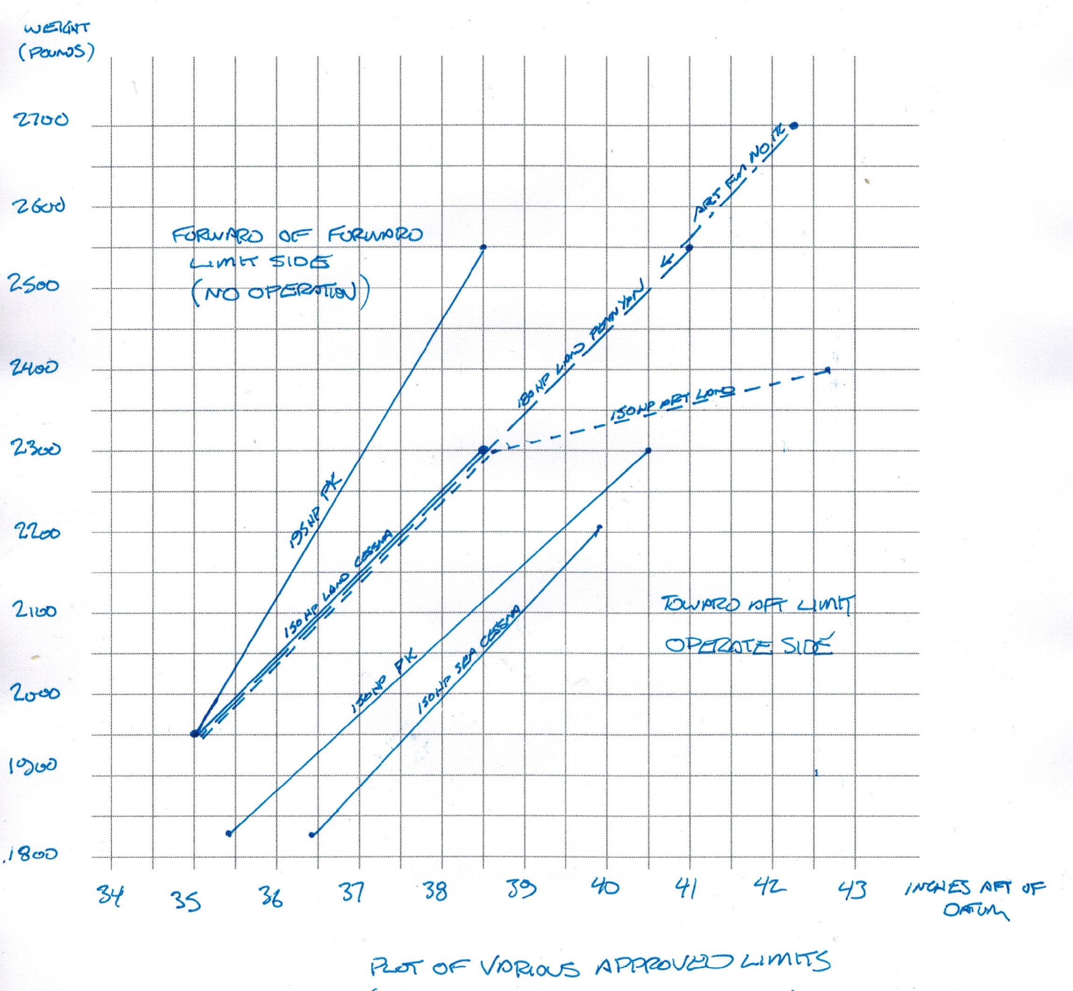
Forward C of G limits by mods
The six different forward C of G limits applicable to the airplane as a result of different modifications installed, and either floats or wheels.
It was necessary to evaluate the various limitations to select the most conservatively applicable for the multi mod sSTC approval issued to approve the combination of the modifications.

Slide 17
Wing Modifications and fuel flow
Multi mod Cessnas commonly include engine change (power increase) by STC, wing changes by STC (STOL kit, wing extensions, VG’s).
The Cessna 180 and 182 is eligible for conversion by STC from a carburetted O-470 engine, to a carburetted modified O-520 or O-550 engine. The latter engines consume more fuel (higher fuel flow). Compliance has been found (and the author has done this fuel flow and flight testing).
These planes are also approved for the installation of STOL kits. When the STOL kit is installed, the airfoil is capable of attaining a higher angle of attack (AoA) before breaking in the stall. At the higher AoA, the fuel flow may no longer be adequate for the higher consuming changed engine.
This unsafe condition is further aggravated by two facts: The engine will run for a minute or so on the contents of the carburettor float bowl, and seem to be fine, until the float bowl is emptied. And, this high AoA, full power situation is likely to be flown when an inexperienced pilot misjudges a water takeoff, and tries to outclimb an obstacle. This is worse, and more likely, in a floatplane off a lake, where a takeoff distance calculation is very difficult.

Slide 18


Author’s fuel flow testing of a Cessna 185, modified with a carburetted TCM-520 engine. It can be seen that the lowest part of the fuel tanks (about where the rear doorpost is) is only slightly above the carburettor, and there are no fuel pumps in this system. Very low head pressure. Extreme high AoA, lightweight testing conducted by the author to establish the least favourable attutitude for sustained flight, and to check the continuing operation of the engine in prolonged flying in this attitude.

Slide 19
reduced Directional Stability – Rudder lock
Float equipped airplanes with STOL kits (which affect aileron effectiveness) and/or VGs and/or wing extensions directional control and stability, and effects of external loads.
Cessna 180 and 185 series floatplanes are known to have directional stability and control more at the minimum for compliance, and approach to “rudder lock” at high rudder deflections. This is in part because of the increased rudder control circuit friction resulting from the addition of water rudder cables, and the added pulleys and water rudder hinge points – the rudder is less likely to naturally return, which reduces directional stability.
With the evolution of the 180 & 185, this has been overcome with the installation of ventral fins, or a spring kit, up inside the aft fuselage ceiling.
Notes:
Changed Directional Stability, Example:
Quote from Wings for the World pg76 – C185 Directional Stability
“The most distinctive feature of the C-185 is the large dorsal fin which is needed for preventing rudder lock (from extreme angles of yaw in power on directional stability tests) in the floatplane. Since the tailwheel steering system had been perfected in the C180 landplane, we believed that the increasing weathervaning tendencies due to the large dorsal fin could be controlled in long taxi runs in strong crosswinds in the C-185 landplane. This belief was confirmed, and, in fact, the same dorsal fin was adopted in the late model C-180 landplanes for commonality on the productions line.
The larger dorsal fin also made the pilot hold greater rudder deflection in cross-wind landing drift correction. This, of course, would cause the steering chains to hold the tailwheel in a misaligned position at touchdown, promoting a violent shimmy in some cases. Thus it was necessary to install a manual tailwheel lock as an anti swivel device. The locking lever, located on the cabin floor console, controlled a spring loaded locking lug on the tailwheel assembly. This device was used, as desired, before each landing. Typically, it was used independently for directional control in the early phase of the landing roll.
Bruce Barrett recalls:
“… the agonies we went through making the camber lift 180-185 floatplanes comply with the contemporary hardline FAA requirements for (primarily) directional stability and control. The first 180J/A185F floatplanes had the big dosal fin added to the 180, a ventral fin, and some rudder centering springs. This was not received well in the field and resulted in the author’s and Ted Moody’s trip north and Bill Bergman’s and my trip south to survey floatplane operational requirements. “I remember one belligerent pilot in the New Orleans area proclaiming his lack of need for “any kiddie car springs”. He was a real pilot! To confuse things further, the New Orleans GADO misinterpreted the maximum demonstrated crosswind figure of 12 or 13 knots to be a limitation which severely limited the Louisiana operators. “As a result of all of the field antagonism and confusion, additional development was accomplished through a lengthy flight test program. Ultimately, the ventral fin addition was eliminated and a non linear spring was added to the rudder control circuit to provide adequate (FAA) centering in flight, but not overly penalizing water maneuvering through excessive pedal forces. Lots of things were tried and lots of hours flown. The final configuration was apparently accepted.”
A cargo pod was installed on the A185F floatplane prototype. However, one flight showed such marked deterioration on lateral and directional behavior that is was quickly removed and wasn’t offered.”

Slide 20
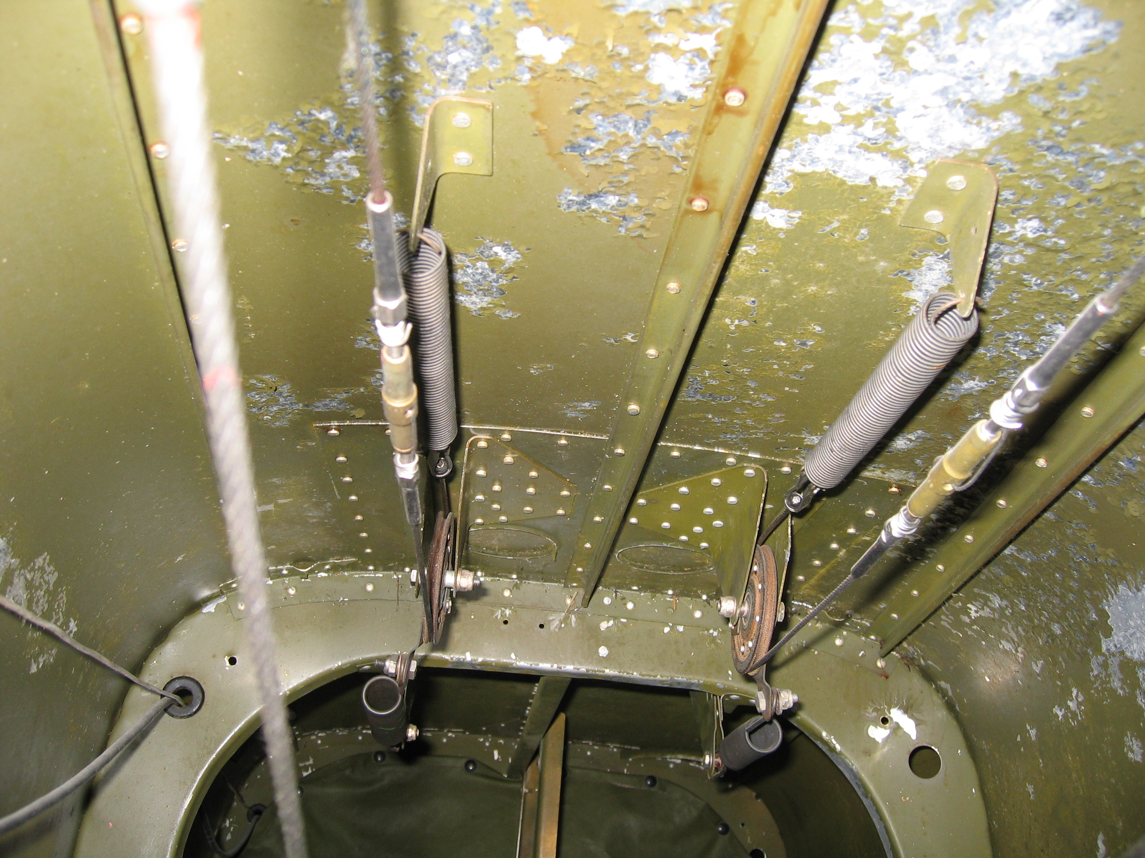
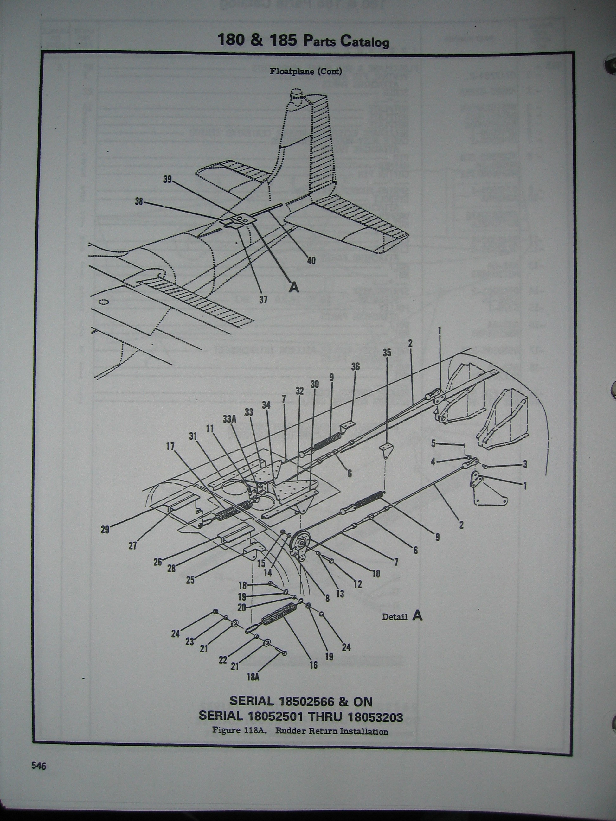
-
The Cessna factory spring kit installed in a Cessna 185. This spring system supplements the aerodynamic effect to allow the rudder to return to center on its own.
Alternatively, a ventral fin might be installed. It will improve directional stability, but will not improve rudder centering.

Slide 21
Rudder lock – continued…
Float equipped Cessna 180/185’s must be evaluated for continued compliance with directional stability when STOL kits (which affect aileron effectiveness) and/or VGs and/or wing extensions are added – the modified plane can fly more slowly, at higher AoA, and rudder lock effects may be increased.
More engine power could increase the effects of rudder lock.
Effects of external loads must be considered for effect on rudder lock.

Slide 22
Cessna A185F Amphibian wing change
The Cessna A185F amphibian had wings from a Cessna 182Q installed as a part of a repair. The author was asked to provide an approval after the fact for this installation. With some thorough data review, and a number of modifications, The author was able to demonstrate design compliance. One issue remained open – the function of the stall warning system.
The 182Q has an electric vane switch where the A185F has a pneumatic stall horn like a 150/152/172. The hole in the leading edge skin is the same size, though in a different location.
The author test flew the airplane, and determined that the pneumatic horn does not provide any warning when installed in the hole for the electric switch. The author experimented with some 100MPH tape, and created a vane which worked. The shop made a permanent vane, and the author was able to calibrate the stall warning system to warn correctly at all configurations.

Slide 23
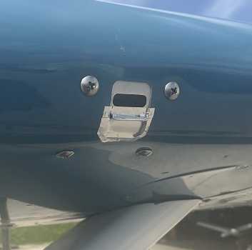
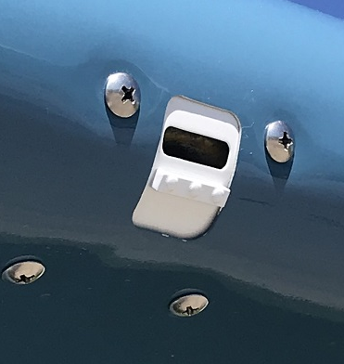

Slide 24
TSB OBSERVATIONS
Report A13P0278, Stall and Collision with Terrain, Cessna 185E C-FQGZ, in BC, October 2013
“The installer’s evaluation of compatibility of modifications made to the aircraft had not included stall testing, and despite the aforementioned conditions, there was no requirement by the regulator for evidence that this had been accomplished.
There was no performance data or procedural guidance for the owner or pilots of C-FQGZ for the combination of modifications on the aircraft.
Without specific guidance and/or a checklist to help the installer determine the interrelationship between STCs, the installer may not be able to ensure that an appropriate evaluation is performed.
The aircraft had several approved modifications that resulted in undocumented performance and handling characteristics.
Notes:
example. In part, it says:
“The installer’s evaluation of compatibility of modifications made to the aircraft had not included stall testing, and despite the aforementioned conditions, there was no requirement by the regulator for evidence that this had been accomplished.
The combined aerodynamic effects of installing multiple STCs onto a single aircraft are not typically tested by the STC holder and were not known.6 Accordingly, there was no performance data or procedural guidance for the owner or pilots of C-FQGZ for the combination of modifications on the aircraft.” (page 10 of 19)
And;
“Following the crash of 2 light aircraft 8 in which it had determined that multiple STCs had been a factor, the National Transportation Safety Board (NTSB) issued a Safety Recommendation Letter9 which states:
The NTSB concludes that, without specific guidance and/or a checklist to help the installer determine the interrelationship between STCs, the installer may not be able to ensure that an appropriate evaluation is performed. As these accidents show, multiple STCs installed on an aircraft can adversely affect each other and, ultimately, the performance and structure of the aircraft if their interaction is not evaluated properly.
And;
Findings
Findings as to causes and contributing factors
1. The aircraft had several approved modifications that resulted in undocumented performance and handling characteristics.
2. The pilot’s expectation of the aircraft’s performance capabilities likely assumed a reduced stall speed that was based on unverified performance.
3. The aircraft experienced an accelerated aerodynamic stall while being flown at an altitude from which recovery was not possible before it collided with terrain.
Findings as to risk
1. If multiple supplemental type certificates are installed without adequate guidance on how to evaluate and document the effects on aircraft handling and performance, there is an increased risk of accidents due to unknown aircraft performance.
2. If advanced stall warning systems, such as angle-of-attack indicators, are not incorporated on aircraft, there is an increased risk of stall accidents. “ (page 16 of 19)

Slide 25
Report A16Q0119, Loss of Control and Collision with Terrain, Cessna U206F C-FWBQ, in Quebec, September 2016
For example, the aircraft’s pre-modification Vne was 182 knots: The wing extension (STC SA914NE) reduced the Vne to 165 knots, and the floats (STC SA1483GL) reduced it again to 158 knots. The stall characteristics of these modifications are unknown, as they have not been adequately evaluated in combination and such an evaluation has not been documented.
(TSB) noted that TC currently requires the installer to evaluate all STC combinations and determine whether the combination of STCs maintains the aircraft’s airworthiness. However, there are no regulatory guidelines to determine the scope or extent of this evaluation or the manner in which it must be performed and documented.
Most light aircraft in Canada, including commercially operated light aircraft, are maintained by smaller approved maintenance organizations with limited capability for aerodynamic testing or engineering evaluations. As a result, the certification for compatibility and interaction between STCs is often made after only limited evaluation.
Notes:
Report A16Q0119, Loss of Control and Collision with Terrain, Cessna U206F C-FWBQ, in Quebec, September 2016 is another example. In part, it says:
1.6.8 Aircraft modifications
1.6.8.1 General
The occurrence aircraft, built in 1975, included several modifications approved by supplemental type certificates (STCs). Some STCs involve modifications to flight characteristics that can sometimes change the aircraft’s operating limits. These new limits are added to the flight manual as supplemental aircraft flight manuals. The following subsections describe the various modifications made to the aircraft.
1.6.8.2 Modifications made to the aircraft in 1996 while it was registered in the United States
The aircraft had 4 modifications made while it was registered in the United States: a Horton Inc. short takeoff and landing (STOL) conversion kit; Wipaire Inc. wing extensions; a Teledyne Continental 300 hp engine and a McCauley 3-blade propeller; and Wipaire Inc. 4000A floats.
1.6.8.2.1 Horton short takeoff and landing conversion kit
In 1996, the occurrence aircraft was modified with a Horton STOL conversion kit in accordance with an approved STC. The conversion kit had been authorized by Horton Inc. for installation on the aircraft.
This modification is intended to improve aircraft takeoff and landing performance by combining improved low-speed manoeuvrability and lower aerodynamic stall speeds. The components of the Horton STOL conversion kit that were installed on the aircraft included wing foil modifications that increased the leading edge profiles (to modify their aerodynamic profile), stall fences, and conical cambered wing tips.
1.6.8.2.2 Wipaire Inc. wing extensions
Wing extensions manufactured by Wipaire Inc. were installed on the aircraft in December 1996 under STC SA914NE. This modification extended each wing tip by 18 inches to increase the aircraft’s rate of climb and stability while reducing its stalling speed and its takeoff and landing distances.
1.6.8.2.3 Teledyne Continental 300-hp engine and McCauley 3-blade propeller
A Teledyne Continental IO-550-F 300-hp engine and a McCauley 3-blade propeller were installed on the aircraft under STC SA1482GL to increase performance and attenuate sound levels.
1.6.8.2.4 Wipaire Inc. 4000A floats
Wipaire Inc. 4000A floats were installed in accordance with STC SA1483GL, such that the takeoff weight was increased to 3800 pounds. The Wipaire supplement contains, among other things, new normal procedures, emergency procedures, and new speed limits, including a never exceed speed (Vne) reduced to 158 knots. The supplement also states that the performance tables in the flight manual apply to this amphibious configuration.
1.6.8.3 Modifications made to the aircraft in 2011 when it was imported into Canada
The aircraft had 2 modifications made when it was imported into Canada: a Sierra Industries STOL conversion kit and Micro AeroDynamics Inc. vortex generators.
1.6.8.3.1 Sierra Industries short takeoff and landing conversion kit
This kit is also known as a Robertson STOL kit.
The aircraft was modified in 2011 by installing a flap–aileron interconnect under STC SA1513WE. This system allows a certain amount of downward aileron deflection when the flaps are deployed. The increased wing camber obtained by lowering the flaps increases lift under the wingtips. This modification is part of a STOL conversion kit made by Sierra Industries that normally includes increased wing foil leading edge profiles, stall fences, and a flap–aileron interconnect. However, similar stall fences and increased wing foil leading edge profiles had previously been installed on the aircraft in 1996 with the Horton conversion kit. As a result, only the Sierra flap–aileron interconnect taken from another aircraft was installed on the occurrence aircraft.
Installing the Sierra conversion kit requires disassembling the Horton kit components, then installing all of the Sierra kit components. However, only a partial installation was performed: the Horton kit components remained on the aircraft, and only the components of the Sierra Industries flap–aileron interconnect were installed on the aircraft.
The aircraft technical records do not indicate that the Sierra conversion kit was only partially installed; they suggest that a full installation was done.
1.6.8.3.2 Micro AeroDynamics Inc. vortex generators
Vortex generators manufactured by Micro AeroDynamics Inc. were installed on the wings, horizontal stabilizers, and fin under STC SA00887SE. Vortex generators are intended to improve control at low airspeeds and high angles of attack by controlling airflow over the wings, horizontal stabilizers, and fin.
1.6.9 Multiple modifications or multiple supplemental type certificates
The initial approval for each modification made under an STC is based on an evaluation for a standard certified aircraft with no modifications other than those stipulated in the STC.
Regulators approve STCs after testing a certified aircraft without any other modifications. Consequently, most TC and FAA-issued STCs include a compatibility statement which states, in part:
Conditions: Prior to incorporating this modification, the installer shall establish that the interrelationship between this change and any other modification(s) incorporated will not adversely affect the airworthiness of the modified product
In addition to this statement, TC issued Airworthiness Notice B045, Compatibility of Multiple Modifications, in 1998, reminding owners, operators, and maintenance personnel that they must ensure that modifications will not affect the airworthiness of the modified product and that a new flight manual supplement may be required with the installation to prescribe the operating envelope.
STC holders do not typically test the aerodynamic interactions of multiple STCs on a single aircraft. The aerodynamic interactions on the occurrence aircraft were not known. For example, the pilot of the occurrence aircraft did not have access to any performance data or operating guidelines regarding the combined modifications made to the aircraft.
Some STCs give specific speed restrictions. However, the combination of installed STCs makes it difficult for pilots to identify the aircraft’s actual speed limits. For example, the aircraft’s pre-modification Vne was 182 knots: the wing extension (STC SA914NE) reduced the Vne to 165 knots, and the floats (STC SA1483GL) reduced it again to 158 knots. The stall characteristics of these modifications are unknown, as they have not been adequately evaluated in combination and such an evaluation has not been documented.
1.6.9.1 Transportation Safety Board of Canada safety concern
Further to its investigation of the October 2013 aerodynamic stall and collision with terrain of a Cessna A185E,34 the Transportation Safety Board of Canada (TSB) noted that TC currently requires the installer to evaluate all STC combinations and determine whether the combination of STCs maintains the aircraft’s airworthiness. However, there are no regulatory guidelines to determine the scope or extent of this evaluation or the manner in which it must be performed and documented.
Most light aircraft in Canada, including commercially operated light aircraft, are maintained by smaller approved maintenance organizations with limited capability for aerodynamic testing or engineering evaluations. As a result, the certification for compatibility and interaction between STCs is often made after only limited evaluation.
In conclusion, the Board issued the following safety concern:
The Board is concerned that, if multiple STCs are installed without adequate guidance on how to evaluate and document the effects on aircraft handling, pilots may lose control of the aircraft due to unknown aircraft performance.
1.6.9.2 National Transportation Safety Board recommendations concerning multiple supplemental type certificates on aircraft
Following the crash of 2 light aircraft in which it was determined that multiple STCs had been a factor, the U.S. National Transportation Safety Board (NTSB) issued a Safety Recommendation Letter stating the following:
The NTSB concludes that, without specific guidance and/or a checklist to help the installer determine the interrelationship between STCs, the installer may not be able to ensure that an appropriate evaluation is performed. As these accidents show, multiple STCs installed on an aircraft can adversely affect each other and, ultimately, the performance and structure of the aircraft if their interaction is not evaluated properly. Therefore, the NTSB recommends that the FAA develop specific guidance and/or a checklist to help installers performing STC modifications determine the compatibility and interaction between a new STC and any previously installed STCs on the aircraft to ensure that the new STC will not adversely affect the aircraft’s structural strength, performance, or flight characteristics. If the guidance and/or checklist indicate any adverse effects between the STCs, additional testing and/or an engineering evaluation should be performed before installing the new STC.
NTSB Recommendation A-12-022 states in part that:
[The FAA should] instruct installers to document […] how the installer determined the compatibility and interaction between the new supplemental type certificate (STC) and previously installed STCs on the aircraft to show that the new STC will not adversely affect the aircraft’s structural strength, performance, or flight characteristics.
In turn, the FAA responded that it was “developing policy and guidance to address STC compatibility concerns that include proposed actions for the installer, the STC applicant, the STC approval holder and the FAA (both engineering and airworthiness inspectors).”
Furthermore, the FAA stated that its Aviation Rulemaking Committee was “considering recommendations for possible regulatory changes to implement more effective STC compatibility assessment procedures.”
On 09 December 2016, the FAA published Advisory Circular 20-188 to provide guidance to aircraft owners and STC installers on determining the compatibility of changes to type design installed on aircraft. The advisory circular lists potentially non-compatible installations, guidelines for owners and operators, and the installer’s responsibilities. It also indicates how to resolve conflicts between non-compatible installations.
A review of the aircraft’s technical records did not indicate that the installed modifications had undergone a compatibility assessment by the installer. Despite the above-mentioned conditions, TC does not require proof that this assessment has been done.

Slide 26

Reference Information
TC Airworthiness Notice B045 – Compatibility of Multiple Modifications
FAA AC20-188, Compatibility of Changes to Type Design Installed on Aircraft, section 7
Australian Civil Aviation Safety Authority AC21-15, Supplemental Type Certificates, 2.13.2
TSB Report A13P0278, (Cessna 185E), Findings as to Risk, 1 & 2
TSB Report A16Q0119, (Cessna U206F), Aircraft Modifications 1.6.8 & 3.2 Findings as to Risk
FAA letter to DepotStar Inc. December 15, 2011, (re: Alpha Systems AoA installation)
Alpha Systems AoA Installation Manual #AOA-9050-Eagle, 4.2, Calibration Checklist Appendix (pdf p88)

